Slide 1
Blue Prism RPA
Centrix Data Solutions Exercise

Slide 2
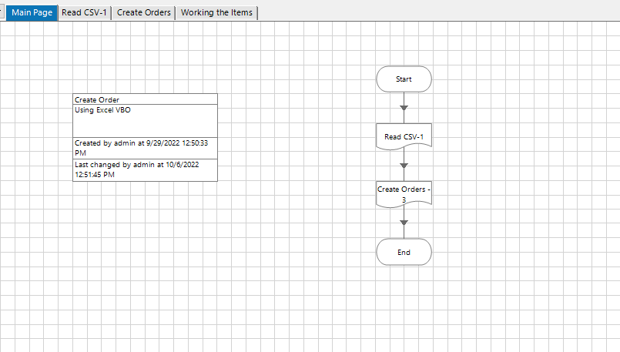
Main Process Main Page

Slide 3
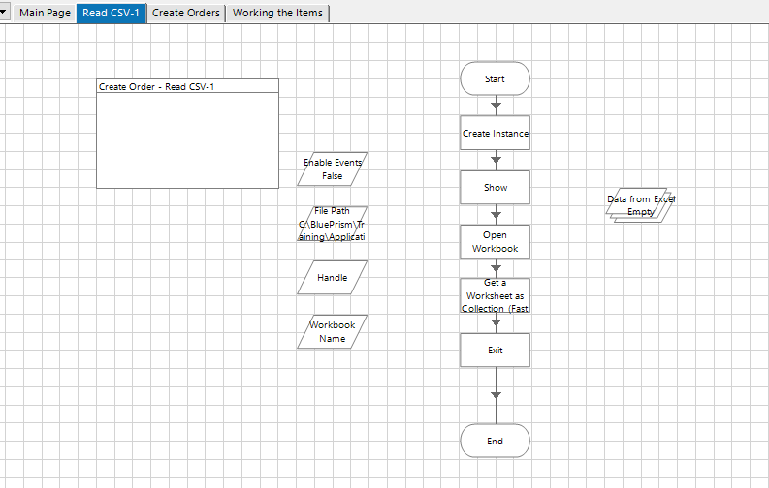
Main Process Read CSV

Slide 4
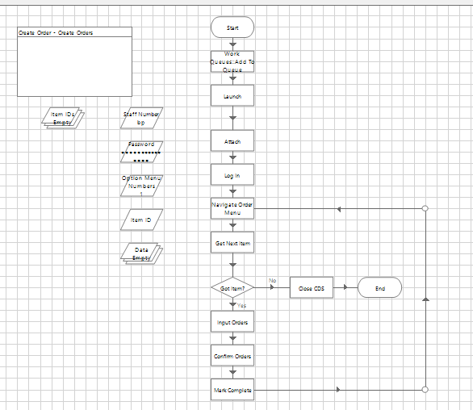
Main Process Create Order

Slide 5
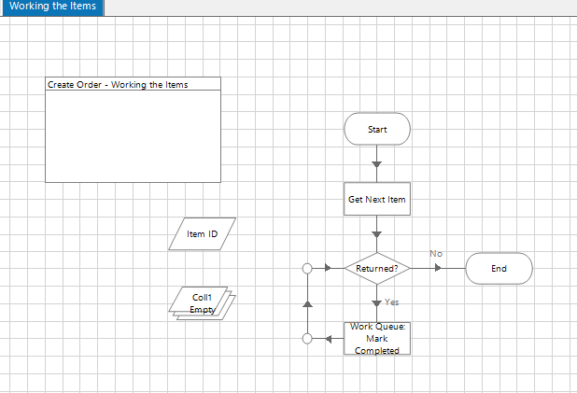
Main Process Working the Items

Slide 6
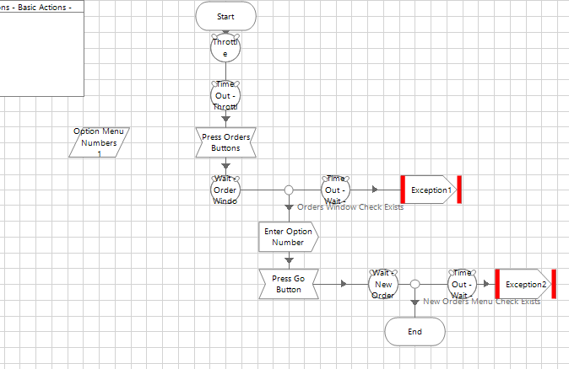
CDS Basic Actions B.O. Navigate Order Menu

Slide 7
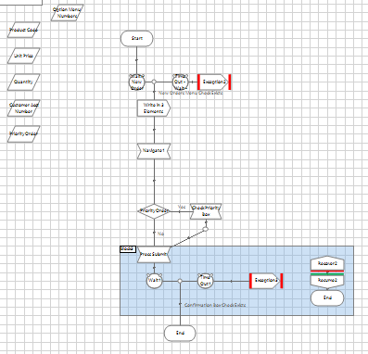
CDS Order Processing B.O. Input Orders

Slide 8
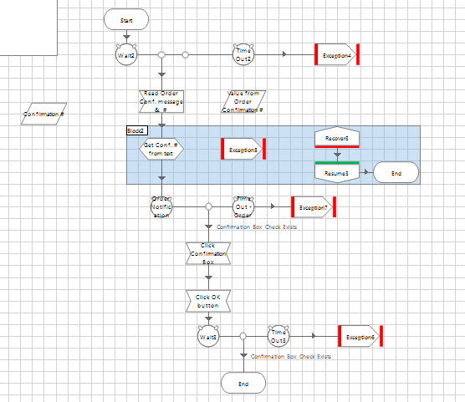
CDS Order Processing B.O. Order Confirmation

